Slide 1

2026 Open Enrollment
Notes:
Hello and welcome to this year’s benefits open enrollment presentation. During this presentation, you will be provided with an overview of the plans offered to eligible employees and family members, along with resources available to assist you with any benefit-related issues now and throughout the year.

Slide 2
Agenda
About Open Enrollment
Mobile Application
Making Your Elections
Benefit Plan Overview
Medical
Family Reimbursement Account
Dental
Spending Accounts
Enrollment Process
Questions & Answers
Notes:
Today, we will discuss what open enrollment is, important elements of Health Care Reform, and key influences on your plan. We'll review our benefit plans for the upcoming plan year, talk about the enrollment process, and discuss the resources available to you for questions.

Slide 3
Key Information
The 2026 Benefit Open Enrollment Period is October 27th – November 10th
All benefit elections and changes will take effect 01/01/2026 and will remain in place for the full plan year, unless you experience an IRS-approved “qualifying event”.
The deadline to enroll is November 10, 2025
During open enrollment, you can:
Add/drop a dependent
Add/drop a benefit
Waive Benefits
Make your annual FSA & HSA Elections
Notes:
The benefits open enrollment period is your opportunity to make changes to your benefit elections and review which dependents you will cover. All benefit elections and changes will take effect on the specified date, and payroll deductions will begin accordingly. Be mindful of the enrollment deadline to ensure your benefits are updated without issue.

Slide 4
New for 2026
$600 annual cash opt out for those that currently waive benefits
$25 cash opt out / member + HRA coverage for those that currently enroll, but waive/change enrollments in 2026
Vison insurance change from Delta to MetLife with decrease in employee paid premiums. Vision enrollment changes due by October 31st.
Notes:
Open enrollment is the one time per year you can make changes to your benefit plans without a qualifying event. A qualifying event, such as marriage, divorce, or the birth of a child, allows you to make changes mid-plan year. Absent one of these events, the only time you can make changes to your benefit selection is during open enrollment. All elections are effective at the start of your plan year!

Slide 5
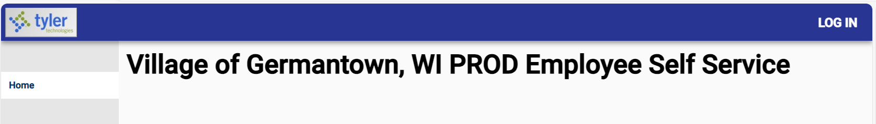
Tyler Munis Self Service
This year, 2026 Open Enrollment will be conducted utilizing a paperless process
through the Tyler Munis Self Service Portal. Training Available through Neogov.
Instructions
Log into:
https://villageofgermantownwi.munisselfservice.com/ess/default.aspx
User Name: Employee ID
Password: Last 4 of Social Security #
Change your password
Select chosen benefits & Update Personal Information

Slide 6
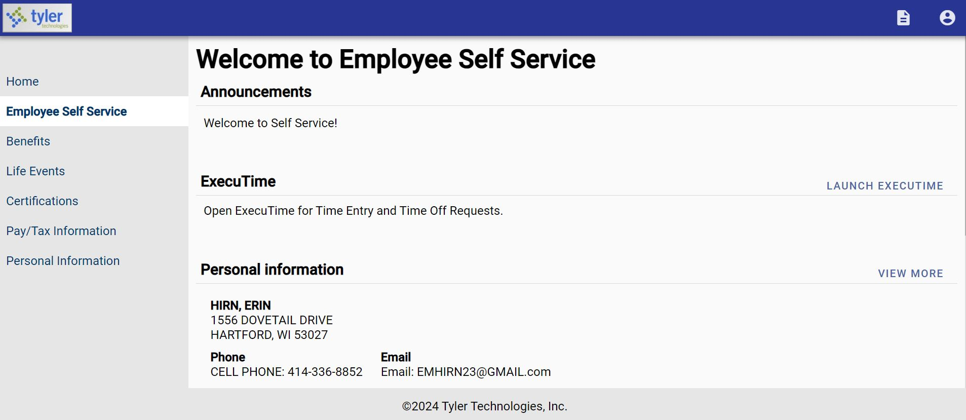
Tyler Munis Self Service

Slide 7
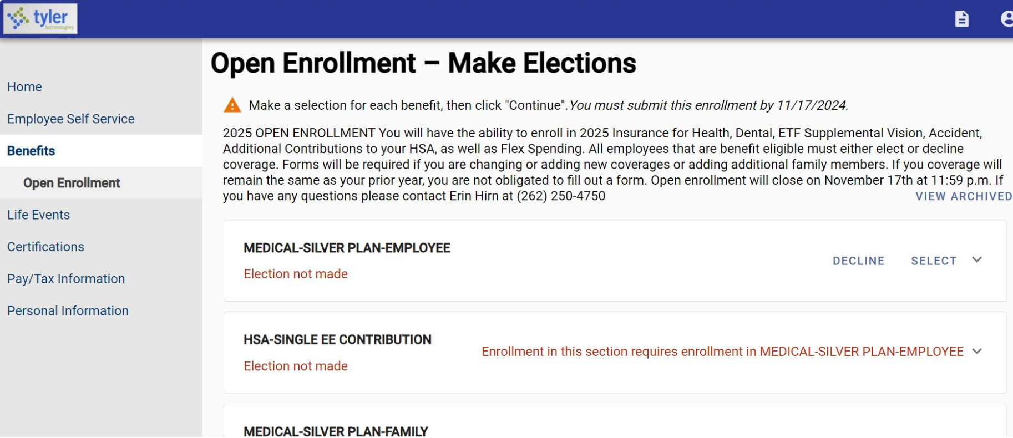
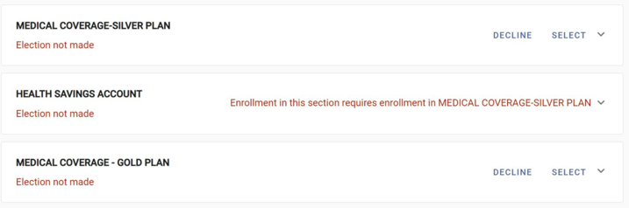
Tyler Munis Self Service

Slide 8
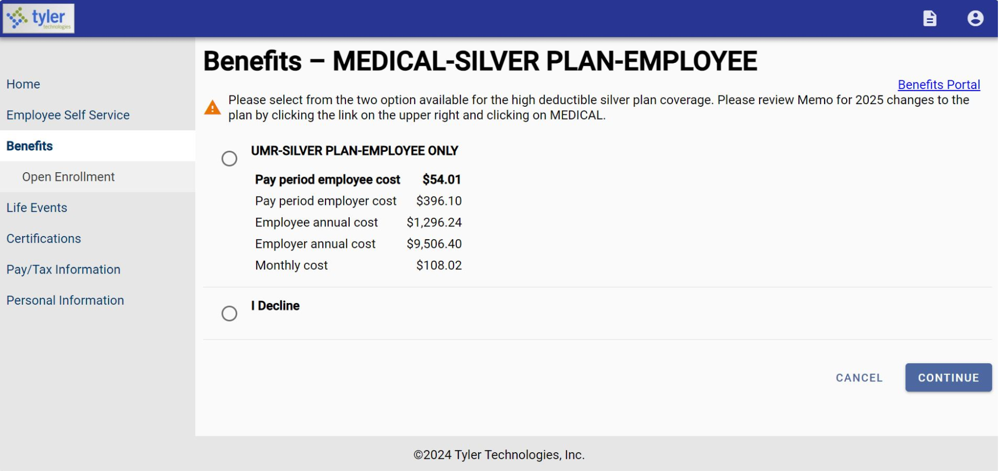
Tyler Munis Self Service

Slide 9
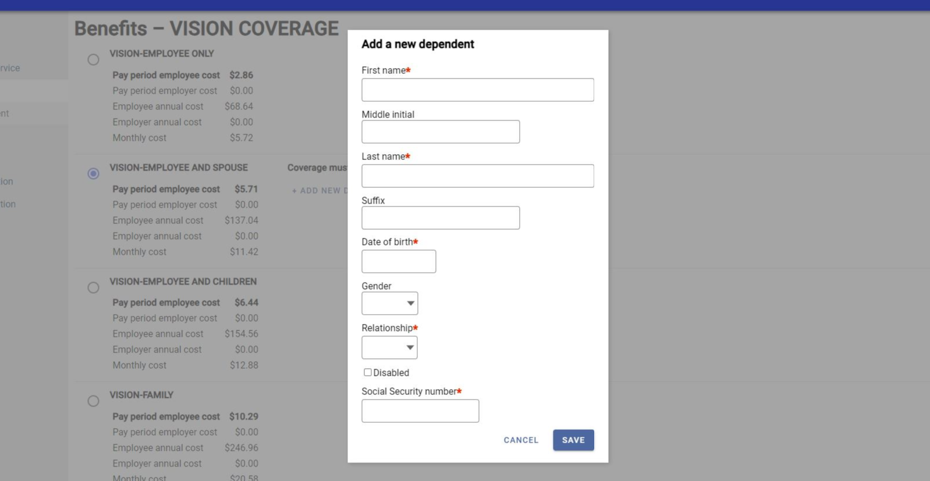
Tyler Munis Self Service

Slide 10
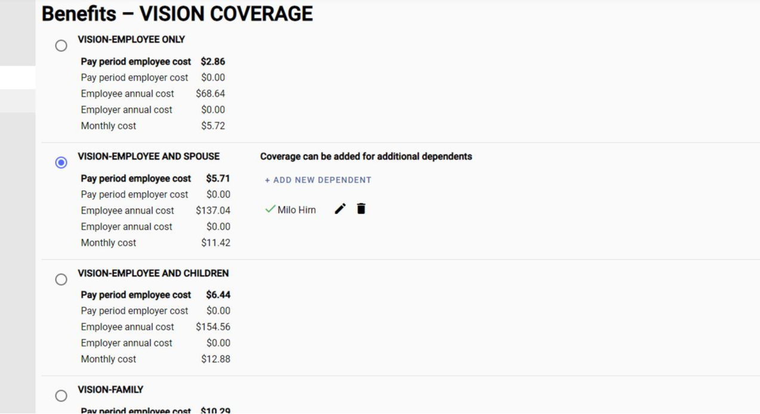
Tyler Munis Self Service

Slide 11
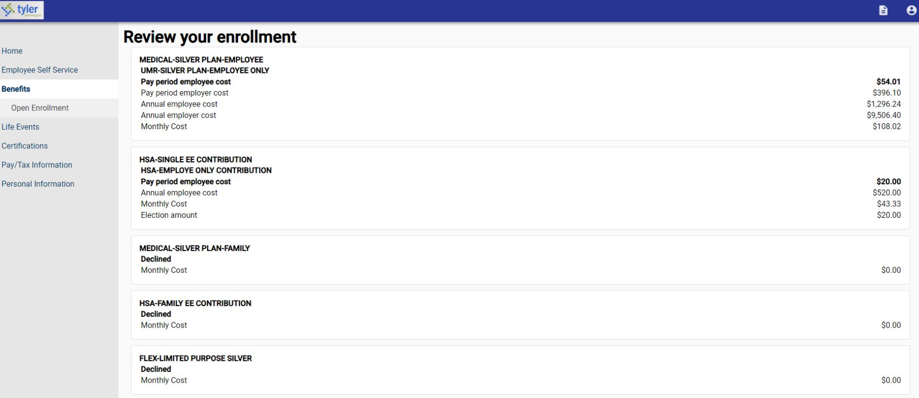
Tyler Munis Self Service

Slide 12
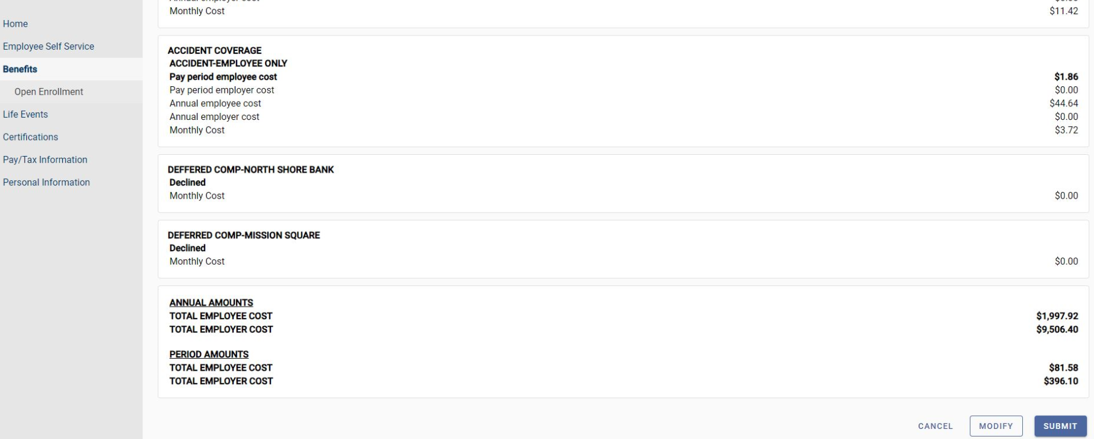
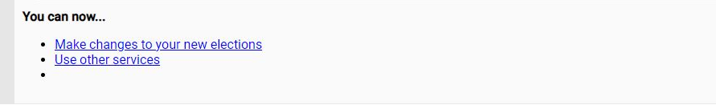
Tyler Munis Self Service

Slide 13
A Year in review
The Village has a self funded medical plan, meaning the Village takes on the medical and claims risk for the health plan.
Employee wellness and primary care engagement has been great in 2025! This has allowed us to keep premiums flat for 2026.
There will be no changes to the Gold or Silver plans.
There will be no changes to the dental plan
We will be rolling out a new cash in lieu benefit and Family Reimbursement Account

Slide 14
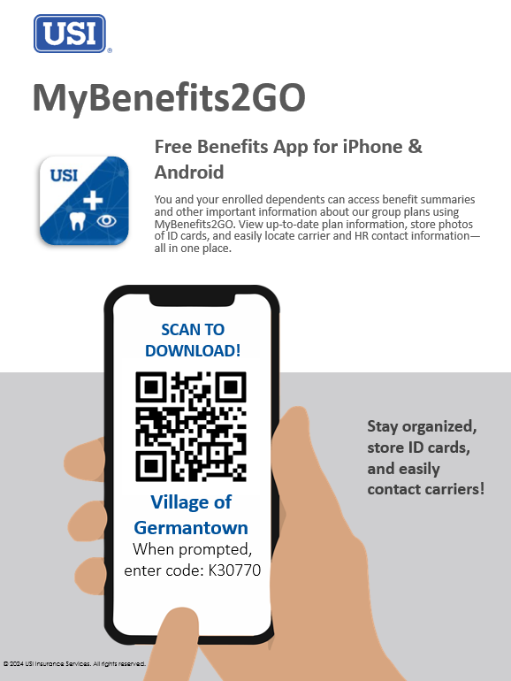
Mobile Application
Notes:
Eligibility for benefits typically depends on your employment status and meeting certain requirements. After a specified waiting period for new employees, you and your family will be eligible for coverage.

Slide 15
Medical/Rx
UMR (TPA)
Notes:
Now, we will review the medical plan options for benefit year.

Slide 16
Medical
 | Gold Plan | Silver Plan
Annual Deductible* | $1,000 per individual $2,000 per family | $3,000 per individual $6,000 per family
Deductible Embedded or Aggregate | Embedded | Aggregate
Annual Out-of-Pocket Maximum** | $5,000 per individual $10,000 per family | $3,000 per individual $6,000 per family
Preventative Care | $0 | $0
Teledoc | $0 | $0
Employee Coinsurance | 10% | 0%
Office Visit | $30 copay per visit after deductible | 100% after deductible
Lab & X-ray | 10% after Deductible | 100% after Deductible
Complex Radiology | 10% after deductible | 100% after deductible
Emergency Room | $300 copay; (waived if admitted) | 100% after deductible (waived if admitted)
HSA Seeding |  | $2,500
*The deductible includes all eligible copays and coinsurance amounts.
**The out-of-pocket maximum includes the deductible all eligible copays and coinsurance amounts.
Notes:
This slide shows key cost sharing amounts for your medical plan options for the upcoming plan year. Take a look to see examples of what your deductible, copays and coinsurance would be for some common services, depending on which plan you elect.

Slide 17
Medical/Rx – Plan Highlights
PREVENTIVE CARE – Covered at 100% on all medical plan options.
Know what services are covered at 100% by UMR (TPA) prior to your preventive care visit
Routine preventive for Children*
Appropriate screenings based on gender and age
Newborn visits
Tuberculosis testing
Anemia testing
Lead exposure
Pelvic exam and pap test
Development and behavior
Lipid profile
Depression
Obesity and counseling
Nutrition counseling
*Birth to age 18
Routine preventive for Adults
Appropriate screenings based on gender and age
Lipid profile
Diabetes
Pelvic exam and pap testing
Breast exam and mammogram
PSA testing
Bone density testing
Colonoscopy
Aortic aneurysm
Notes:
Preventive care is covered at 100% on all medical plan options. This includes routine preventive care for adults and children, based on gender and age. Some services might include lipid profile, diabetes, pelvic exam and pap testing, breast exam and mammogram, PSA testing, bone density testing, colonoscopy, and aortic aneurysm.

Slide 18
Medical/Rx – Plan Highlights
 | Gold Plan | Silver Plan
Generic | $15 copay | 0% after deductible
Preferred Brand Name | $45 copay | 0% after deductible
Non-Preferred Brand Name | $90 copay | 0% after deductible
Preferred Specialty | 20% cost up to $150 maximum | 0% after deductible
Mail-Order Prescriptions
Mandatory for Maintenance Rx? | No | No
Generic | $30 copay | 0% after deductible
Preferred Brand Name | $90 copay | 0% after deductible
Non-Preferred Brand Name | $180 copay | 0% after deductible
Preferred Specialty | 20% cost up to $150 maximum | Not covered
Notes:
Here are some further examples of what your cost sharing would be for each plan option, focused specifically on prescription drug benefits.

Slide 19
Medical/Rx – Plan Highlights
Employee Contributions (Per Pay Cycle)
Single Coverage | Gold Plan |  | Silver Plan
2026 Cost Sharing | Employee pays 12% getting to Silver status | Employee pays 25% not getting to Silver status | Employee pays 12% getting to Silver status | Employee pays 25% not getting to Silver status
Monthly Premium | $1,052.66 | $1,052.66 | $900.22 | $900.22
Village Monthly Share | $926.34 | $789.50 | $792.19 | $675.17
Employee Monthly Share | $126.32 | $263.17 | $108.03 | $225.06
Pay Period Deduction Amount | $63.16 | $131.58 | $54.01 | $112.53
Family Coverage | Gold Plan |  | Silver Plan
2026 Cost Sharing | Employee pays 12% getting to Silver status | Employee pays 25% not getting to Silver status | Employee pays 12% getting to Silver status | Employee pays 25% not getting to Silver status
Monthly Premium | $2,525.56 | $2,525.56 | $2,160.94 | $2,160.94
Village Monthly Share | $2,222.49 | $1,894.17 | $1,901.63 | $1,620.71
Employee Monthly Share | $303.07 | $631.39 | $259.31 | $540.23
Pay Period Deduction Amount | $151.53 | $315.70 | $129.66 | $270.12
Notes:
Here are some further examples of what your cost sharing would be for each plan option, focused specifically on prescription drug benefits.

Slide 20
Which is the best plan?
While we can not recommend a plan for you, some things to consider when selecting your medical plans for 2026:
 | Gold Plan | Silver Plan
Would you rather pay more money as you incur services or pay more each pay period? | Most money out of your paycheck – set copays for many services. | Least amount of money out of your paycheck-you will pay more when you incur services.
Do you take expensive o r several prescription drugs? | If yes, the deductible does not apple and there are set copays per prescription type. | If yes, are you comfortable with paying 100% of the cost up to your deductible then the applicable copay up to the OOPM?
Are you looking for a tax advantaged savings method? | This plan gives you access to an FSA | This plan gives you access to a limited purpose FSA and HSA.
Are you covering a dependent on the medical coverage? | If yes, this plan has a separate deductible and OOPM per person-it is not an aggregate basis. | If yes, are you comfortable with the family deductible and OOPM?
Which plan is better? | Both are quality plans. If just depends on your financial point of view, medical needs and long-term financial goals and objectives. Both plans provide comprehensive coverage and include an out-of-pocket maximum (though the amount varies based on plan selection)
Notes:
The plan you choose should be based on the anticipated usage of you and your family. Consider the healthcare needs and options available to all members of your family.

Slide 21
How do I Maximize my Benefits?
Am I using in-network facilities and providers?
Do I know the urgent care facilities near my home for minor emergencies? Can I use Teledoc?
Have I asked my doctor or pharmacist for lower cost prescription alternatives or shopped around pharmacies for lower prices?
Have my family and I had our annual preventive services performed?
Do I know where I stand regarding my deductible and coinsurance before services are received?
Notes:
To maximize your benefits, use in-network facilities and providers, know the urgent care facilities near your home, ask your doctor or pharmacist for lower-cost prescription alternatives, ensure your family and you have had annual preventive services performed, check where you stand regarding your deductible and coinsurance before services are received, and compare your Explanation of Benefits (EOB) to provider charges.

Slide 22

Family Reimbursement Account
Who is eligible?
Any employees enrolled on the Village’s plan as of 10/1/25 or hired after 10/1/25.
To receive the benefits of the Family Reimbursement Account the member must enroll in the other employer sponsored coverage for 1/1/26.
What are the benefits?
100% of in-network out-of-pocket medical expenses will be reimbursed. For example, a $5,000 surgery bill would be reimbursed in full.
You will receive a $25 per member per month payroll bonus. For example, a family of 6 would receive $150 per month, or an additional $1,800 per year.
You will receive a debit card for claims reimbursement unless you accept HSA dollars from the other employer sponsored coverage.
Why is the Village offering this program?
This is a 100% voluntary benefit that we believe will benefit numerous employees and their families.
If you currently waive coverage, you will receive a $600 annual cash in lieu for 2026 but must complete an affidavit form.

Slide 23
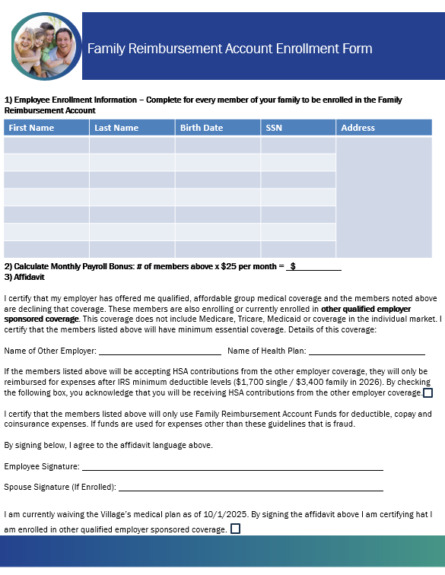
Family Reimbursement Account

Slide 24
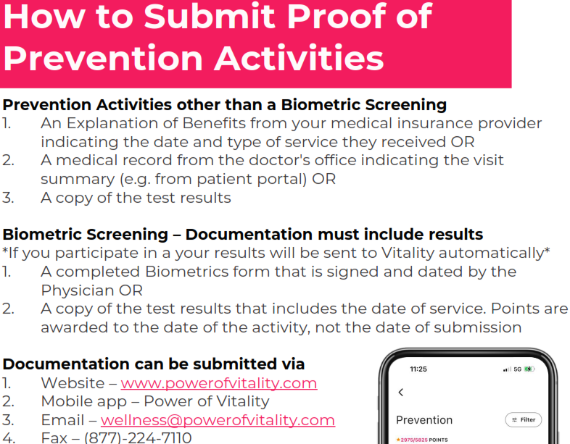
Vitality – How to submit activities
*The deductible includes all eligible copays and coinsurance amounts.
**The out-of-pocket maximum includes the deductible all eligible copays and coinsurance amounts.
Notes:
This slide shows key cost sharing amounts for your medical plan options for the upcoming plan year. Take a look to see examples of what your deductible, copays and coinsurance would be for some common services, depending on which plan you elect.

Slide 25
Dental & Vision

Slide 26
Dental – No Change
 | Benefits
Annual Deductible | $25 per individual $75 per family
Benefit Maximum | $1,300
Deductible Waived for Preventive Care | Yes
Preventive Care | 100%
Basic Services* | 80%
Major Services* | 50%
Orthodontia Services | $1,000
*Endodontics and periodontics are listed under Basics Services (or Major Services) – update to applicable category

Slide 27
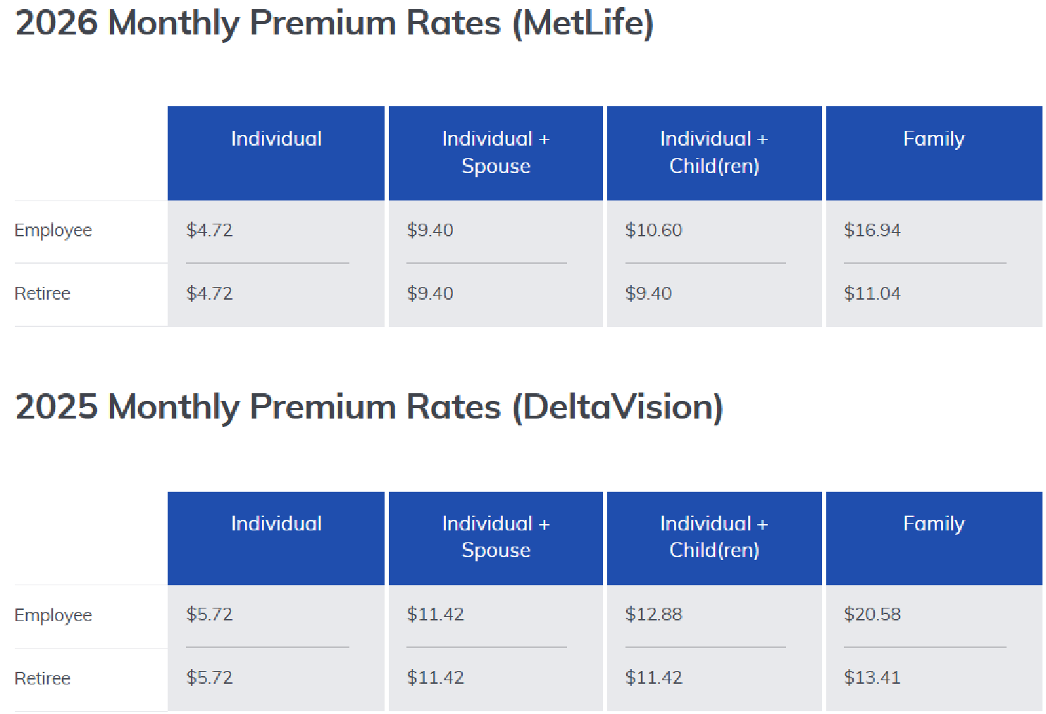
Vison – MetLife (Superior Vision Network)
Elections must be made by 10/30 for vision coverage

Slide 28
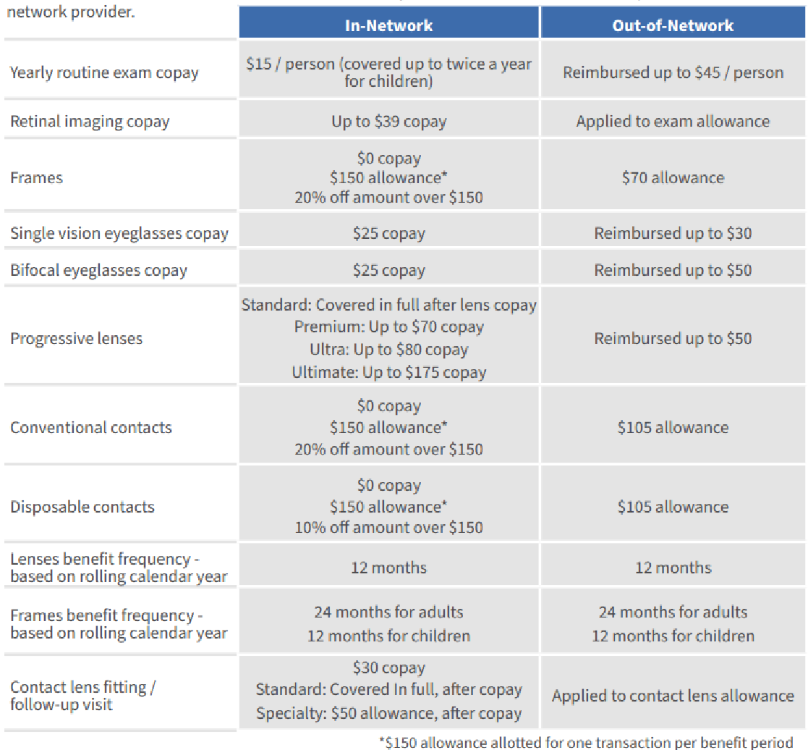
Vison – MetLife (Superior Vision Network)

Slide 29
Spending Accounts
Diversified Benefit Services, Inc. PNC Bank
Notes:
Now we will cover tax benefit accounts available to you through your employer.

Slide 30
Flexible Spending Accounts
Medical FSA – If you are enrolled in the traditional medical plan, you can contribute up to $3,400 in a Medical FSA for medical, dental and vision expenses.
Limited FSA – If you are enrolled on the HSA medical plan, you can contribute up to $3,400 in Limited FSA that can only be used on dental and vision expenses.
Dependent Care FSA – Up to $7,500 per household for dependent care expenses.
Important: If you wish to make and FSA election, you will need to make a selection in the Tyler portal. This selection will trigger an email with separate instructions from Diversified to enroll in your FSA benefits through the Diversified portal. Please watch your emails for this important information.
The 3,400 is a projected amount for 2026 dependent on IRS approval, if the $3,400 is not approved the limit will be $3,300.
FSA enrollment will be separate online enrollment.
Notes:
You have a Flexible Spending Account available to you, should you choose to elect this benefit. When you enroll and choose your contribution level, be conservative; this decision can’t be changed during the plan year, and FSA plans are use-it-or-lose-it, meaning the funds won’t roll over to next year.

Slide 31
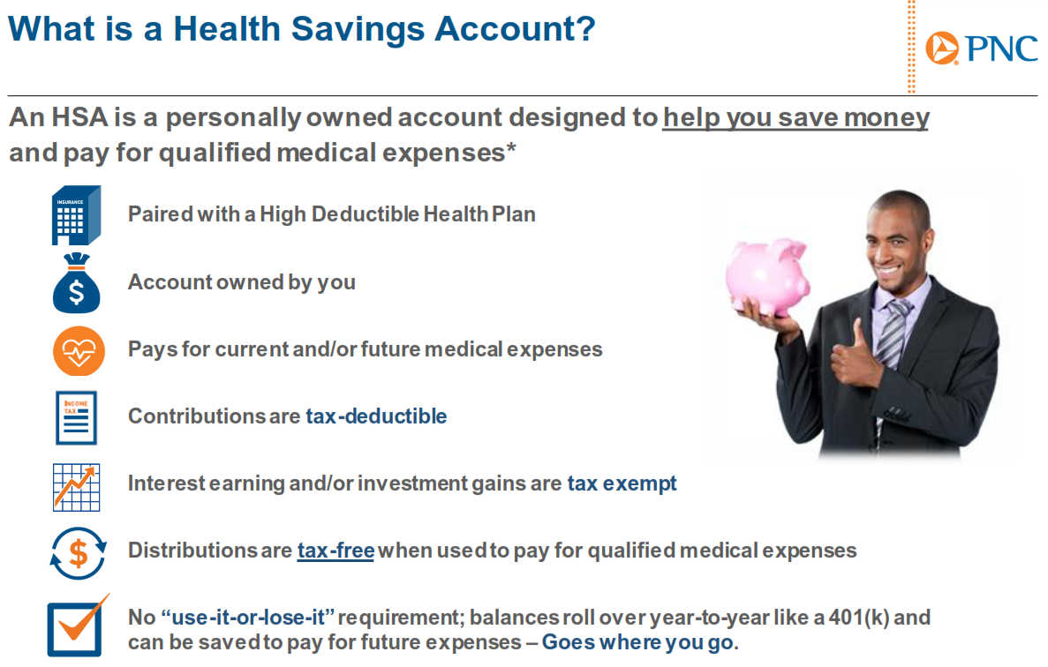
Notes:
An HSA is an account you can use to pay medical expenses, giving you tax advantages to offset your medical costs. There are eligibility rules, and you must spend the dollars on qualified medical expenses and keep itemized receipts. Health Saving Accounts are powerful long-term savings vehicles if they are right for you.

Slide 32
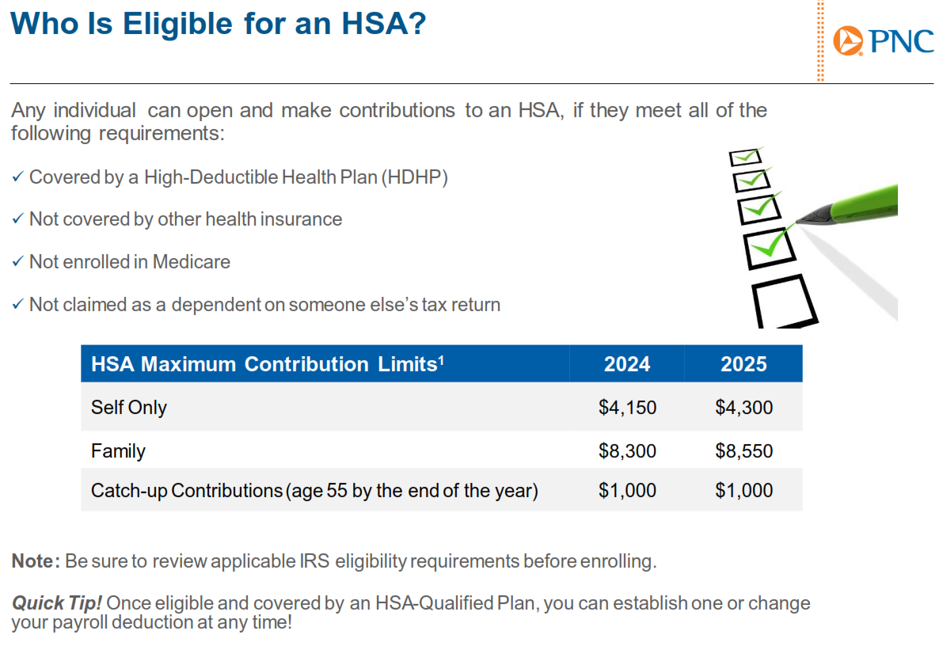
HSA Maximum Contribution Limits | 2025 | 2026
Self Only | $4,300 | $4,400
Family | $8,550 | $8,750
Catch-up Contribution Limits | $1,000 | $1,000
Notes:
HSAs have maximum contribution limits for individuals and families. These maximums include any employer contributions. Those 55 years and older and not enrolled in Medicare can contribute an additional $1000 catch-up each year.

Slide 33
Enrollment reminders
After your initial enrollment period, you may only make changes to your benefits during Open Enrollment unless you have a “qualifying event.”
Mid-year changes are only permitted if you have a qualifying event.
Enrollment must occur within 30 days of the event or you will have to wait until the next Open Enrollment.
Documentation of the qualifying event is required.
Approved qualifying events include:
Marriage or Divorce
Death
Birth or adoption of a dependent
Change in employment status
Change in dependent’s eligibility status
Loss of or significant change to your current coverage
Judgment, decree or court order
All enrollment elections and qualifying event changes must be made in the Tyler Munis System.
Notes:
The USI Benefit Resource Center or BRC provides free, confidential help on resolving elevated claims issues and other issues you need help with related to your benefits. BRC contact information is listed on the slide.

Slide 34
Thank you for your participation in this year’s open enrollment presentation
All election changes are due by: November 10th
Notes:
Thank you for your participation in this year’s open enrollment presentation. Make sure to complete your election changes by the end of the enrollment period.

