Slide 1
2025 Employee Benefits Open Enrollment
Notes:
Welcome to the 2025 Employee Benefit Open Enrollment

Slide 2

Agenda
About Open Enrollment
Mobile Application
Making Your Elections
Benefit Plan Overview
  Medical
  Dental
  Spending Accounts
Enrollment Process
Questions & Answers
Notes:
In our presentation today, we’ll review some key information for open enrollment, next, we will go through the different insurance benefits offered to you. We will also briefly touch on the enrollment process.

Slide 3
About Open Enrollment
  Benefit Open Enrollment Period is 10/28/24 – 11/17/24
  All benefit elections and changes will take effect 01/01/2025 and will remain in place for the full plan year, unless you experience an IRS-approved “qualifying event”.
  The deadline to enroll is 11/17/2024
During open enrollment, you can:
  Add/drop a dependent
  Add/drop a benefit
  Waive Benefits
  Make your annual FSA & HSA Elections
This year’s open enrollment requires ACTION. You must make enrollment elections prior to the deadline, or all of your current enrollments will be cancelled for 2025. You will not have any coverage (or you will only have company-paid life/disability benefits) if you do nothing this year.
Notes:
Open enrollment is October 28th – 11/17th, with benefit elections and changes taking effect January 1, 2025
This year’s open enrollment is ACTIVE and requires ACTION. You must confirm benefit elections and dependent information prior to the deadline. If you do not take action, your current benefits will expire on December 31, 2024, and you will ONLY have company-paid life and disability insurance on January 1, 2025
You 2025 elections and changes will take effect on January 1, 2025 and will remain in place for the full plan year, unless you experience a life qualifying event, such as marriage, birth or adoption of a child, or divorce.
The deadline to enroll is November 17th.
Keep in mind that if you are waiving benefits, some states, including California, Massachusetts, New Jersey, Rhode Island, Vermont, and the District of Columbia require health insurance and may impose a tax on residents who do not have health insurance coverage.

Slide 4
A Year In Review
The Village has a self funded medical plan, meaning the Village takes on the medical and claims risk for the health plan.
Employee wellness and primary care engagement has been great in 2024! This has allowed us to keep premiums flat for 2025.
For 2025 we will be making our Silver plan richer and simpler. The out-of-pocket max will drop to $3,000 for singles and $6,000 for families.
There will be no changes to the Gold plan.
For 2025 the Village is rolling out a benefits app which will store a recording of this presentation, an updated benefits guide and store your ID cards.

Slide 5
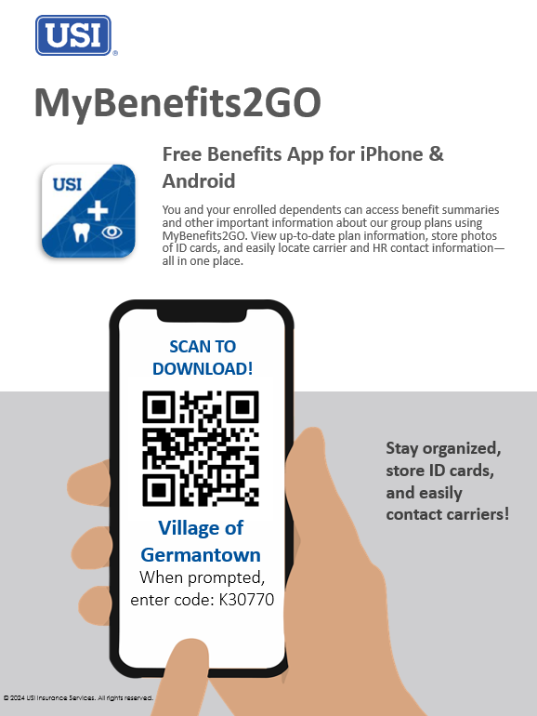
Mobile Application
Notes:
MyBenefits2GO is a quick and simple way for you and your enrolled dependents to access benefit summaries and other important information about your group plans. Store photos of ID cards and easily locate carrier and HR contact information—all in one place. The app is free and available for iPhone and Android.

Slide 6
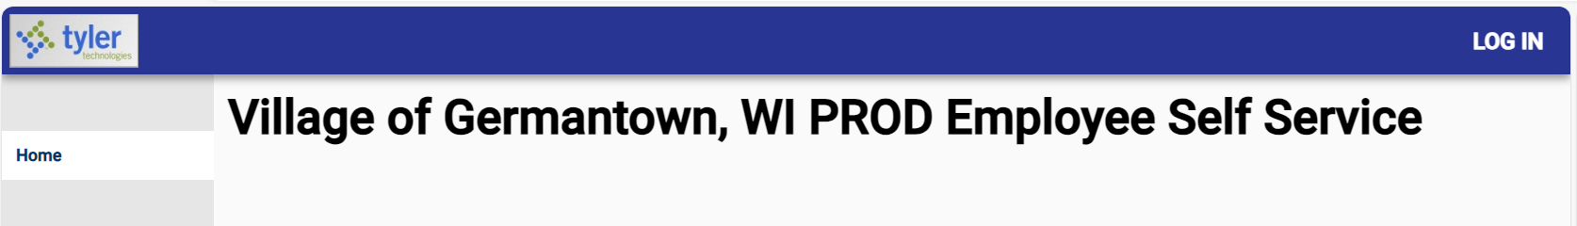
Tyler Munis Employee Self Service
This year, 2025 Open Enrollment will be conducted utilizing a paperless process
through the Tyler Munis Self Service Portal. Training Available through Neogov.
Instructions
Between Oct. 28 -Nov. 17th Log into:
  https://villageofgermantownwi.munisselfservice.com/ess/default.aspx
User Name: Employee ID
Password: Last 4 of Social Security #
Change your password
Select chosen benefits & Update Personal Information
Notes:
This year the 2025 open enrollment will be conducted utilizing a paperless process through the Tyler Munis Self Service Portal. Between October 28th and November 17th you will need to log into the link listed, enter your user name and ID, once you have initially logged in, you will be instructed to change your password. From there you will select your benefits and update any personal information. This information can also be located in the October newsletter.

Slide 7
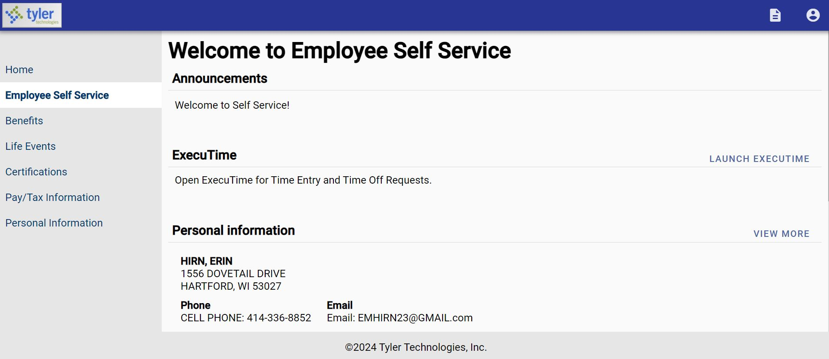
Tyler Munis Employee Self Service
Name
Address
Cell Email
Notes:
Once you have completed the log in process you will be brought to this landing page. Please make sure to verify all information for accuracy. When you are done, please select benefit from the menu bar on the right.

Slide 8
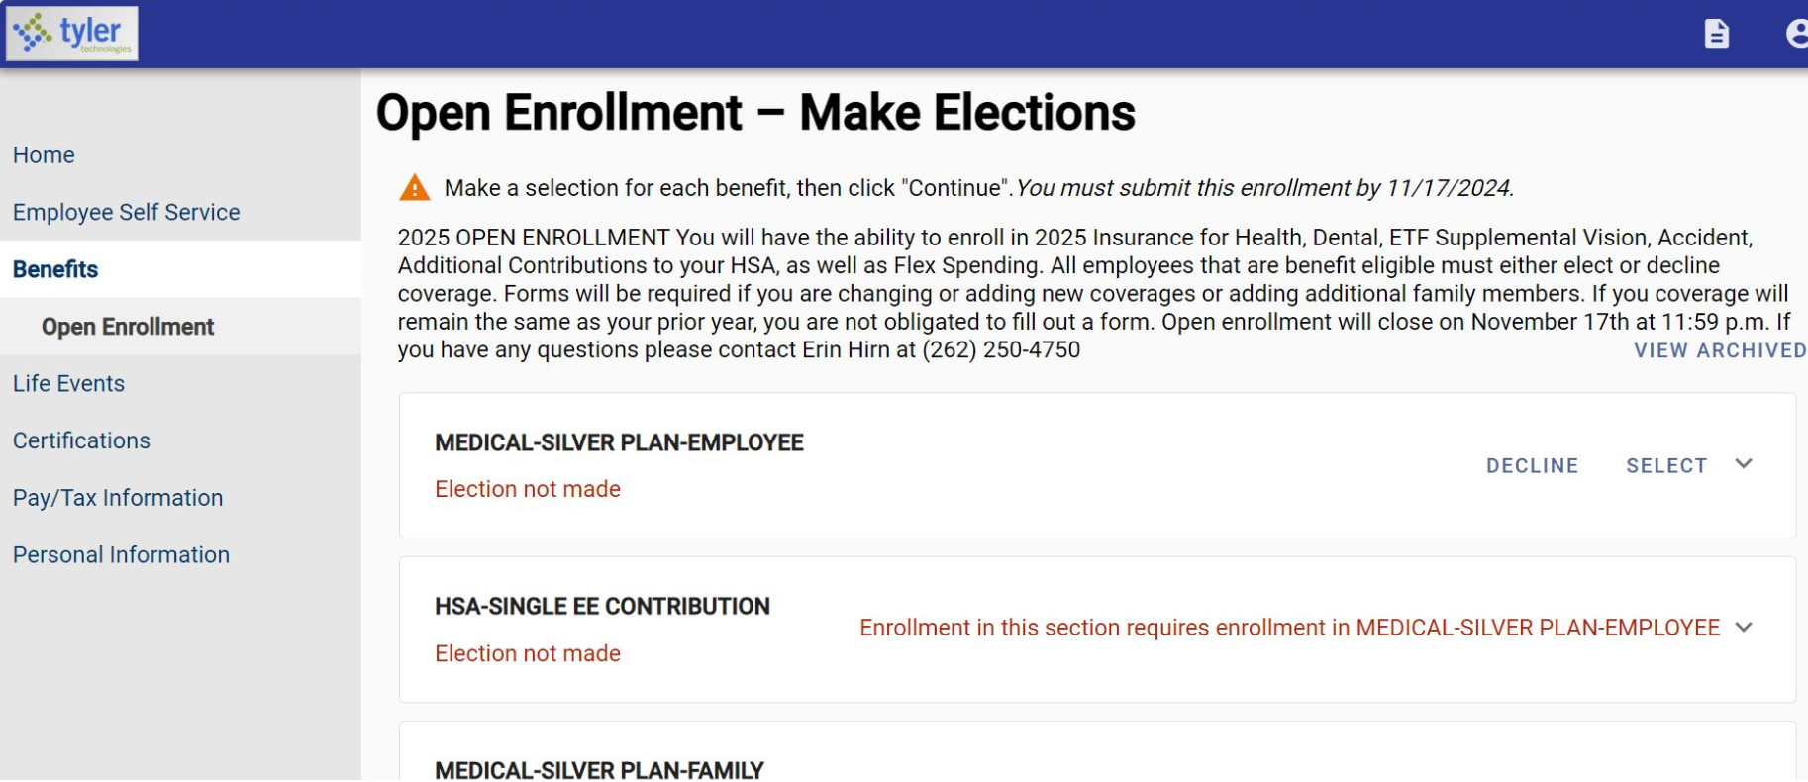
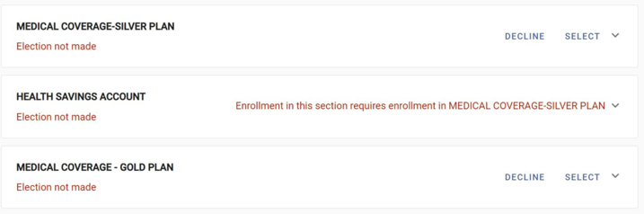
Tyler Munis Employee Self Service
Notes:
When you select Benefits from the menu on the right it will bring you to the open enrollment landing page where you will begin to make elections. From this point you will have the ability to enroll in the 2025 insurance for health, dental, ETF Supplemental Vision, Accident, make contribution elections for your HSA as well as your FSA. All employees that are benefit eligible must either elect or decline coverage for each line of coverage. To make elections you will use the Select drop down. Please note for the medical plans, if you make an election for one plan you must decline the other plan.

Slide 9
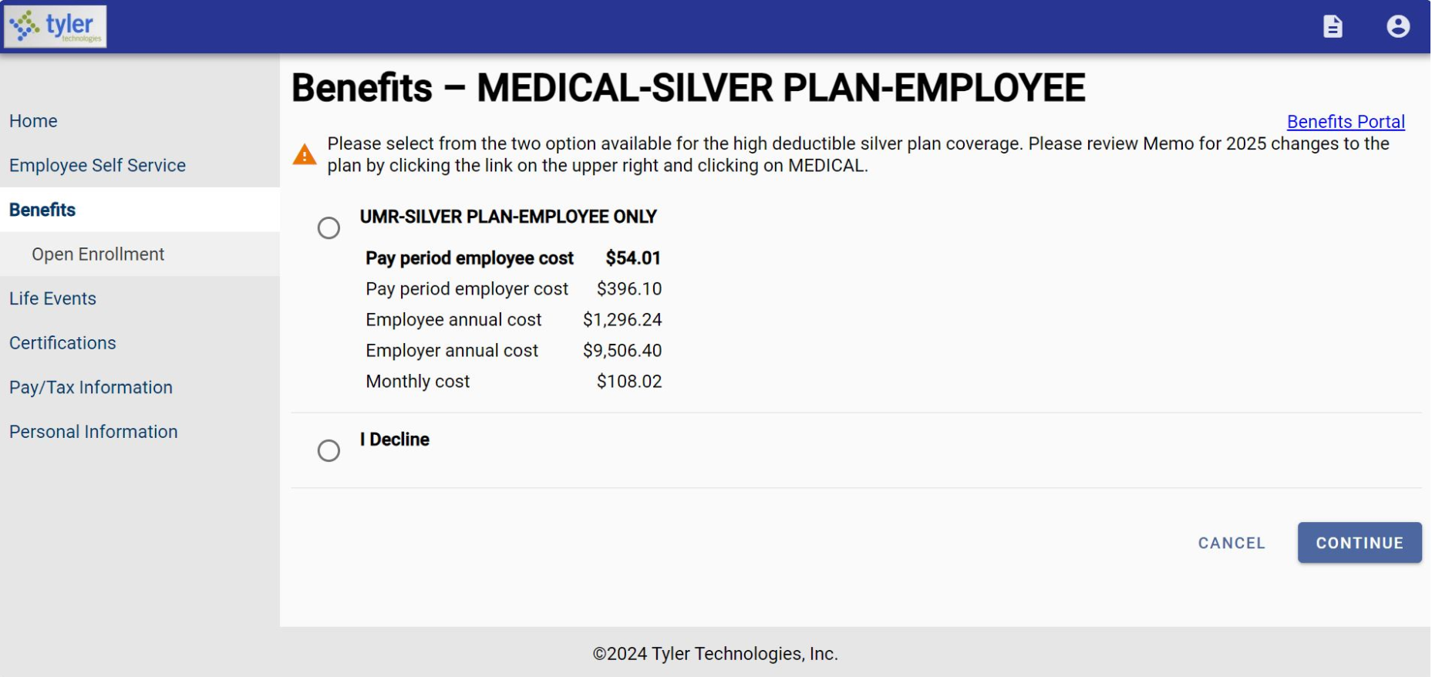
Tyler Munis Employee Self Service
Notes:
Once you have made your selection from the select drop down you will be brought to this page. From here you will either make the benefit election accepting the premium cost or decline coverage. Once you have made your selection you will select continue.

Slide 10
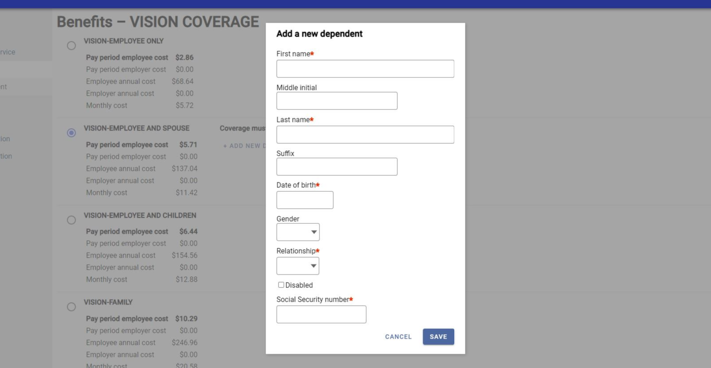
Tyler Munis Employee Self Service
Notes:
After you make your election, you will have the opportunity to add dependents by clicking on the add new dependent link, you will need to complete all fields with asterisks. You will need your dependents social security number so please have those available when making elections.

Slide 11
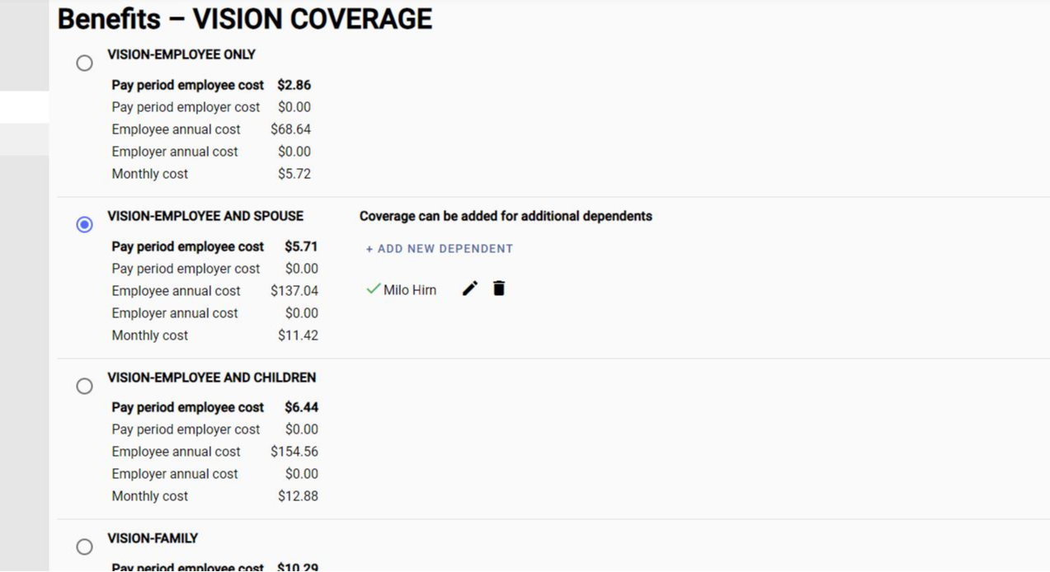
Tyler Munis Employee Self Service
Name of enrolled dependent(s) will appear here.
Notes:
When you have added your dependent, they will appear next to a green check mark. You will have the opportunity to make any edits or delete a dependent.

Slide 12
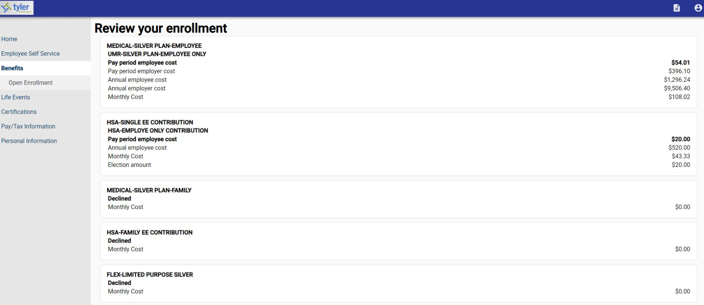
Tyler Munis Employee Self Service
Notes:
Once you have made your elections you will have the opportunity to review your enrollment elections.

Slide 13
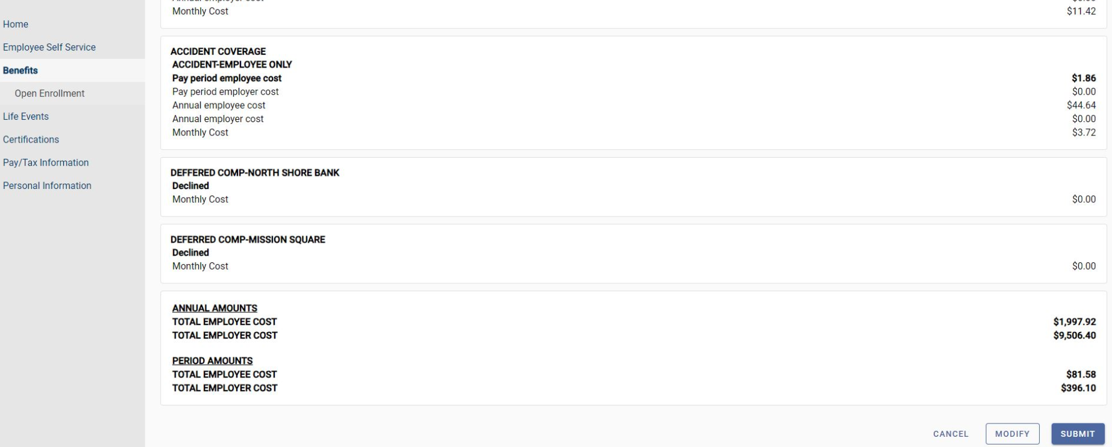
Tyler Munis Employee Self Service
Notes:
After you have reviewed your benefit elections, you will have the opportunity to make modifications or submit your 2025 benefit elections.

Slide 14
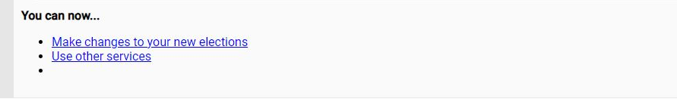
Tyler Munis Employee Self Service
Notes:
Once you submit you will still have an opportunity to make changes to your elections up to 11/17/2024

Slide 15
Medical/Rx
UMR
Notes:
Let’s review your medical and pharmacy benefits through UMR

Slide 16
Medical/Rx – Features
There will be no increases in employee premiums for 2025
The maximum out of pocket cost on the Silver plan will decrease to $3,000 for singles and $6,000 for families.
Coinsurance and copays on the Silver plan will be eliminated in an effort to simplify this plan
There will be a slight increase in the Silver plan deductibles, increasing $500 for singles and $1,000 for families
Benefit | Current Silver Plan | 2025 Silver Plan | 2025 Gold Plan
Annual Deductible (Indiv/Fam) | $2,500 / $5,000 | $3,000 / $6,000 | $1,000 / $2,000
Preventive Care | 100% | 100% | 100%
Coinsurance | 90% after deductible | 100% after deductible | 90% after deductible
Annual Out-of-Pocket Maximum (Indiv/Fam) | $6,350 / $12,700 | $3,000 / $6,000 | $5,000 / $10,000
NOTE: Please refer to your vendor benefit summaries for a detailed listing of covered benefits. Benefits listed in this presentation are for illustrative purposes only.
Notes:
The Village of Germantown is excited to announce there will be no increases in employee premiums for the 2025 benefit plan year.
The maximum out of pocket cost on the Silver plan will decrease from $6,350 to $3,000 for individuals and from $12,700 to $6,000 for families.
The copays and coinsurance on the Silver plan will be eliminated to simplify the plan.
There will be a slight increase to the individual and family deductibles. One you have satisfied the deductible, all services will be covered at 100%.

Slide 17
Medical/Rx – Plan Highlights
**The out-of-pocket maximum includes the deductible all eligible copays and coinsurance amounts.
 | Silver Plan | Gold Plan
Annual Deductible* | $3,000 per individual $6,000 per family | $1,000 per individual $2,000 per family
Deductible Embedded or Aggregate | Aggregate in Network Aggregate out of Network | Embedded in Network Embedded out of Network
Annual Out-of-Pocket Maximum** | $3,000 per individual $6,000 per family | $5,000 per individual $10,000 per family
Plan Coinsurance | 100% | 90% in most cases
Office Visit | 100% after Deductible | $30 copay per visit
Lab & X-ray | 100% after Deductible | 90% after Deductible
Complex Radiology | 100% after Deductible | 90% after deductible
Inpatient Hospital | 100% after Deductible | 90% after deductible
Emergency Room | 100% after Deductible | $300 copay
Notes:
Medical/Rx Features – Village of Germantown will continue to offer two medical plans for the 2025 plan year. One low copay plans, as well as a high deductible HSA compliant plan. In the Copay plan, most of your outpatient services are at a set out of pocket cost and the deductible only applies to certain services. The HSA plan requires members to pay a deductible before any plan benefits apply. Plan benefits are represented as coinsurance or percentage of the cost of a service.
Medical Plan Highlights – EXPLAIN FEATURES OF THE DIFFERENT PLANS. Unless the group has new plans, only focus on a few key features. DO NOT READ ALL FEATURES.
PICK PROPER EMBEDDED OR NON-EMBEDDED INFORMATION:
For families, it is important to know that this plan is embedded. Embedded means that if one person in the family is sick or hurt, he or she cannot exceed the single deductible on his or her own. This is an added level of protection for families.
For families, it is important to know that this plan has a non-embedded deductible. Non-embedded means there is not an individual deductible. So, the overall family deductible must be reached, either an individual or by a combination of enrolled family members, for the insurance to pay for services.

Slide 18
Medical/Rx – Plan Highlights
 | Silver Plan | Gold Plan
Retail Prescription Drugs
Generic (Tier 1) | 100% after deductible | $15 copay
Preferred Brand Name (Tier 2) | 100% after deductible | $45 copay
Non Preferred Brand Name (Tier 3) | 100% after deductible | $90 copay
Preferred Specialty (Tier 4) | 100% after deductible | 20% cost up to $150 maximum
Mail-Order Prescriptions
Mandatory for Maintenance Rx? | No | No
Generic (Tier 1) | 100% after deductible | $30 copay
Preferred Brand Name (Tier 2) | 100% after deductible | $90 copay
Non Preferred Brand Name (Tier 3) | 100% after deductible | $180 copay
Preferred Specialty (Tier 4) | 100% after deductible | 20%

Slide 19
Which Is The Best Plan?
While we can not recommend a plan for you, some things to consider when selecting your medical plan for 2025 :
 | QHDHP | Traditional PPO Plan
Would you rather pay more money as you incur services or pay more each pay period? | Least amount of money out of your paycheck – you will pay more when you incur services. | Most money out of your paycheck – set copays for many services.
Do you take expensive or several prescription drugs? | If yes, are you comfortable with paying 100% of the cost up to your deductible then the applicable co-pay up to the OOPM? | If yes, the deductible does not apply and there are set copays per prescription type.
Are you looking for a tax advantaged savings method? | If yes, this plan allows you to set aside money in an HSA that you can use for healthcare expenses or retirement. | If yes, this plan does not provide access to any special accounts like an HSA.
Are you covering a dependent on the medical coverage? | If yes, are you comfortable with the family deductible and OOPM? | If yes, this plan has a separate deductible and OOPM per person – it is not on an aggregate basis.
Which plan is better? | Both are quality plans. It just depends on your financial point of view, medical needs and long term financial goals and objectives. Both plans provide comprehensive coverage and include an out-of-pocket maximum (though the amount varies based on plan selection).
Notes:
Remember, you have the choice to enroll in the medical plan that best fits the needs of you and your family.
In general, people can be categorized as it pertains to their healthcare utilization. Ask yourself the questions shown on the screen now:
Are you a high utilizer, someone who habitually meets your deductible and out of pocket maximum in a year
OR are you the opposite, a low utilizer, someone who rarely goes to the doctor and has very few medical or prescription drug expenses.
OR maybe you are somewhere in the middle. Your medical and drug costs are unpredictable from year to year.
If you fall into either the high or the low utilizer category, you will probably benefit from the HSA plan. If you fall into that “middle” category, the traditional plan may be better for you.
Be sure to use the UMR resources to make the best choice for you!

Slide 20
Dental - No Change
*Endodontics and periodontics are listed under Basics Services (or Major Services) – update to applicable category
 | Benefits
Annual Deductible | $25 per individual $75 per family
Benefit Maximum | $1,300
Deductible Waived for Preventive Care | Yes
Preventive Care | 100%
Basic Services* | 80%
Major Services* | 50%
Orthodontia Services | $1,000
Notes:
There will be no changes to the coverage under the dental plan for the coming 2025 calendar plan year. Employees who elect to participate in the dental plan will have a $50 ded for individuals and up to $150 deductible for family coverage. A $1,000 benefit maximum per covered member will be applied to your dental services this coming plan year.
Remember, all preventive services, including your annual exam and cleanings will be covered at 100% and are not subject to the plan deductible. You can receive these services up to [2] times per year.

Slide 21
Spending Accounts
PNC Bank
Diversified Benefit Services, Inc.
Notes:
Now we move on to different types of accounts that can be paired with the Medical plans to help you take advantage of tax breaks.

Slide 22
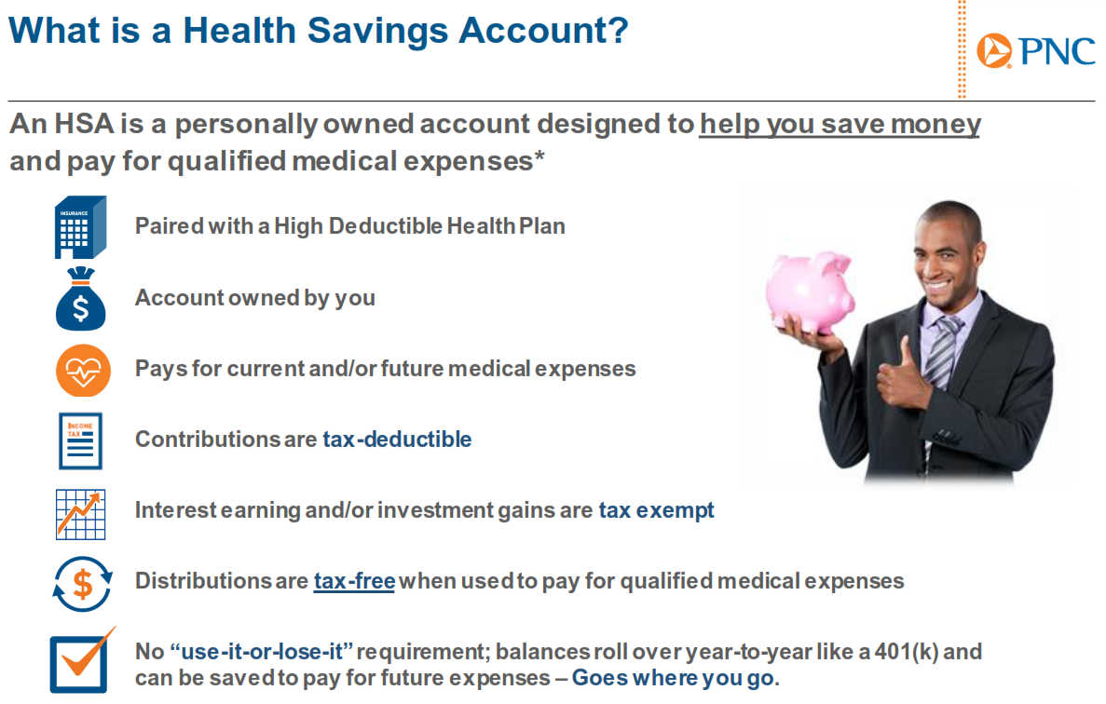
Notes:
Village of Germantown will begin using PNC Bank for Health Savings Accounts. For members who currently have HSA accounts you have the option of maintaining your existing health savings account or moving funds to PNC Bank. New accounts opened on January 1st or later will be placed with PNC Bank.
What is a Health Savings Account or HSA? An HSA is a personally owned account which is designed to help account holders save money and pay for qualified medical expenses.
HSA’s are paired with a qualified high deductible health plan
You own the account
Funds in the account are used to pay for current and future medical expenses
Contributions are tax deductible
Distributions are tax free when used to pay for qualified medical expenses
Funds roll over year over year

Slide 23
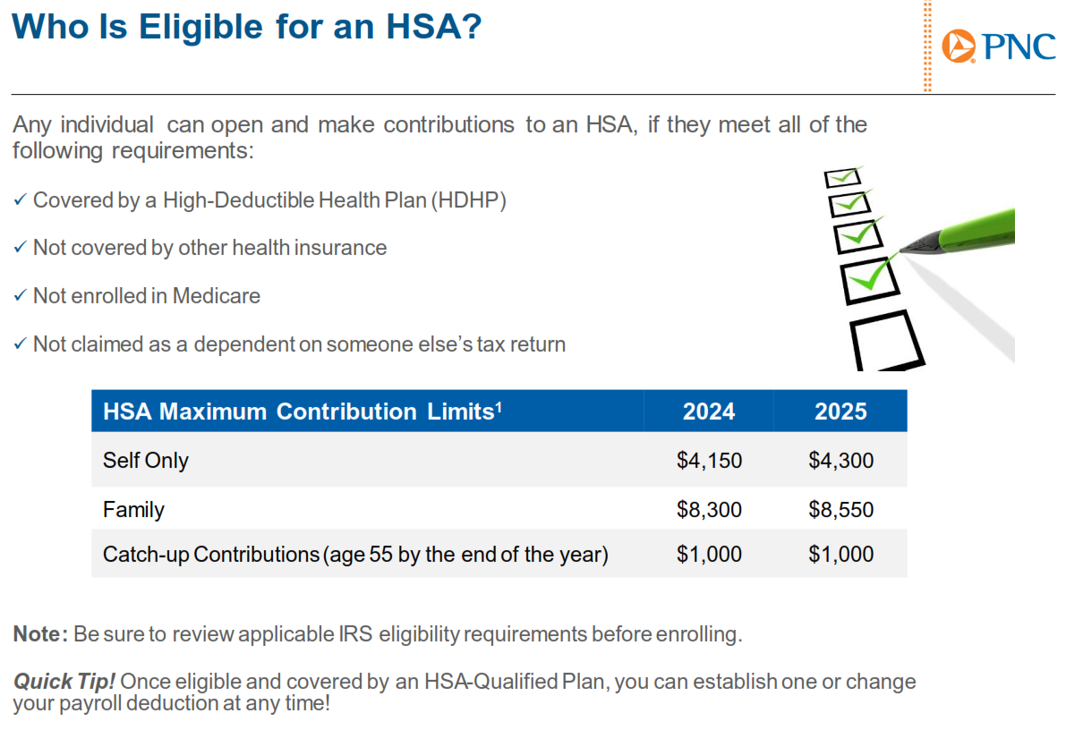
Notes:
In order to have a health savings account there are certain requirements.
You are covered by a high deductible health plan
Not covered by other health insurance
Not enrolled in medicare
Not claimed as a dependent on someone else’s tax return
The maximum contribution amount for 2025 is $4,300 for individuals and $8,550 for families.
These limits include contributions made by the Village of Germantown
$1,250 for individuals
$2,250 for families
The most you can contribute to the HSA personally is
$3,050 for individuals
$6,050 for families
Individuals age 55 or older by the end of 2025 may make a catch up contribution of $1,000, this amount does not get included in the maximum contribution amount, it’s in addition to.

Slide 24
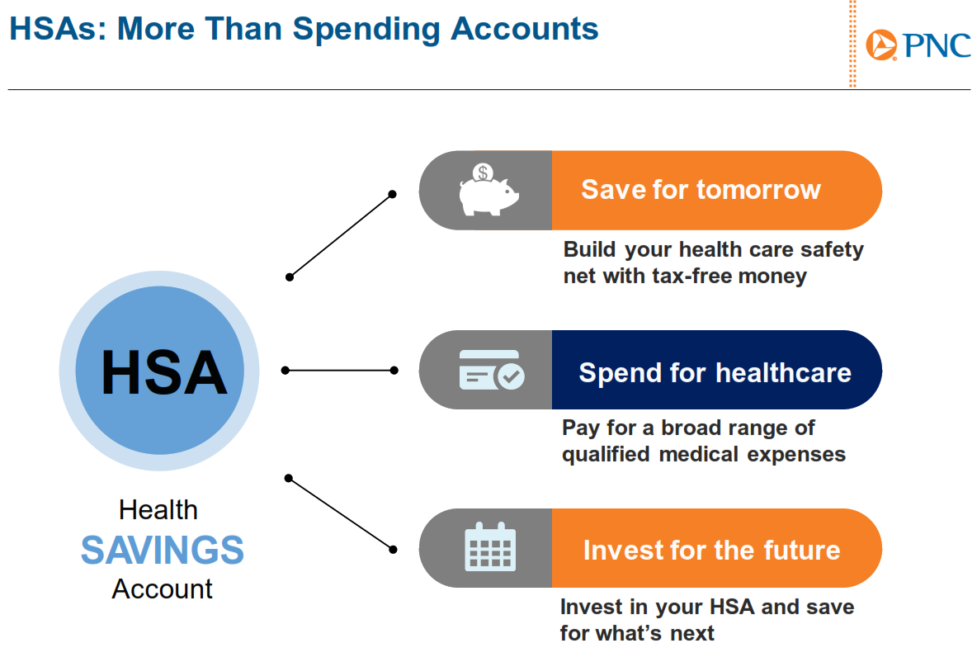
Notes:
An HSA is more than a spending account.
You can save for tomorrow by building a health care safety net with tax free money
Pay for qualified medical expenses
You also have the ability to use the HSA as an investment for your future

Slide 25
Flexible Spending Accounts
Medical FSA – If you are enrolled in the traditional medical plan, you can contribute up to $3,300 in a Medical FSA for medical, dental and vision expenses.
Limited FSA – If you are enrolled on the HSA medical plan, you can contribute up to $3,300 in Limited FSA that can only be used on dental and vision expenses.
Dependent Care FSA – Up to $5,000 per household for dependent care expenses.
Important: If you wish to make and FSA election, you will need to make a selection in the Tyler portal. This selection will trigger an email with separate instructions from Diversified to enroll in your FSA benefits through the Diversified portal. Please watch your emails for this important information.
Notes:
Next we will take a look at the three types of flexible spending accounts you have access to.
For members who are not covered by the silver plan you have the option to make an annual election for 2025 of $3,300. You may use these funds for medical, dental, and vision expenses.
For members who do enroll in the silver plan you have access to a limited purpose FSA. You may use these funds only for dental and vision expenses
All members also have access to the Dependent Care FSA. This allows you to elect up to $5,000 to help offset the cost of dependent care with pre-tax dollars.

Slide 26
Enrollment Reminders
After your initial enrollment period, you may only make changes to your benefits during Open Enrollment unless you have a “qualifying event.”
  Mid-year changes are only permitted if you have a qualifying event.
  Enrollment must occur within 30 days of the event or you will have to wait until the next Open Enrollment.
  Documentation of the qualifying event is required.
Approved qualifying events include:
  Marriage or Divorce
  Death
  Birth or adoption of a dependent
  Change in employment status
  Change in dependent’s eligibility status
  Loss of or significant change to your current coverage
  Judgment, decree or court order
All enrollment elections and qualifying event changes must be made in the Tyler Munis System.
Notes:
Just a few enrollment reminders –
After your initial enrollment period as a new hire, Open Enrollment is the one time of year for you to change plans, elect new benefits or terminate a benefit altogether. It’s also the time that you can add or remove dependents.
Any changes you make will be effective January 1, 2025 (or after initial eligibility) and remain in effect through the plan year unless you have what’s called a “qualifying event” like the ones shown here. If you have a qualifying event, you have 30 days from the date of the event to notify Human Resources and process the change in the Tyler Munis System.

Slide 27
Thank you for your participation in this year’s open enrollment presentation.
All election changes are due by: 11/17/2024

